Slide 1






END-TO-END LENDING
DATA PIPELINE
Date: Aug 23, 2025
Track: Data Engineering Fayoum

Slide 2




AGENDA
AGENDA
Introduction
01
Batch Pipeline
05
Our Team
02
Stream Pipeline
06
Business Problem
03
Insights
07
Dataset and Data Archeticture
04
Conclusion
08

Slide 3











OUR TEAM
Khaled Salah
Ahmed El-Sayed
Abdelrahman Tarek
Mohamed Ibrahim
Mohamed Badr
Mahmoud Khalid

Slide 4




INTRODUCTION
Who is Lending Club ?
01
Founded in 2006 in San Francisco; pioneered P2P lending
03
Since its inception, LendingClub has facilitated over $90 billion in loans, connecting millions of borrowers and investors.
02
Enabled unsecured personal loans ($1K–$40K) via investor-funded notes
04
The platform has served over 4.7 million members, making it one of the largest digital marketplaces for credit in the United States.

Slide 5
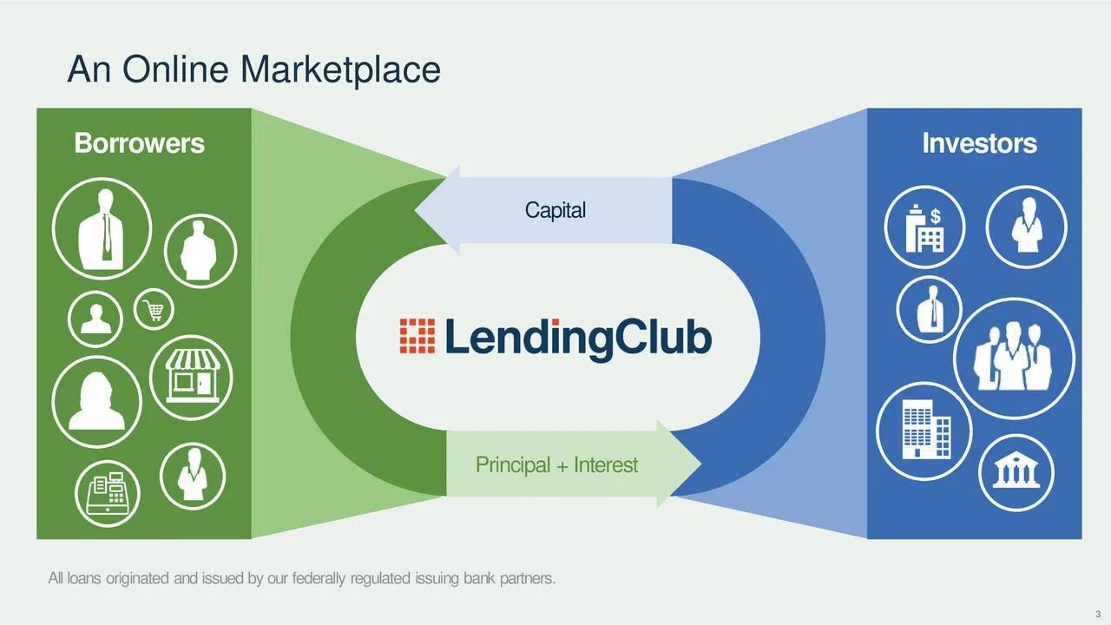
LendingClub Concept

Slide 6

LendingClub Boom Reasons
Investors can cash out their money by selling their loan to another investor.

Slide 7

LendingClub Boom Reasons
Borrowers can ask for any type of loan without giving any guarntees.

Slide 8
BUSINESS PROBLEMS

Slide 9
We need to look at ..
How to assess the risk ?
How do we process and track billions of dollars in payments, interest, and fees
How we are going to have pre-cautionary steps and reduce defaulted loans as much as possible
How can we track the business metrics and make sure that we know where the business is headed.
How can we engineer an efficient marketplace that simultaneously maximizes value for our borrowers and minimizes risk for our investors?

Slide 10


OUR VISION
Background
Inspired by Lending Club’s peer-to-peer lending model, we analyzed the dataset to explore borrower risk factors and evaluate investment performance. Our focus was on simplifying these insights to make them more accessible and actionable for decision-makers.
Mission Statement
To build a smarter, data-driven lending platform that reduces risk, improves trust, and maximizes opportunities for both borrowers and investors.

Slide 11
OUR VISION - II
Problem Statement
Traditional lending models make it difficult for investors to identify trustworthy borrowers and for borrowers to access fair opportunities. The lack of transparency and efficiency creates barriers for both sides.
Approach
We designed a batch data pipeline that ingests raw CSV files, transforms them into structured tables, and integrates with Snowflake, dbt, Airflow, and Power BI. This enabled reliable reporting, risk analysis, and simplified decision-making.

Slide 12
DATASET

Slide 13

ABOUT DATASET
LendingClub is a US peer-to-peer lending company, headquartered in San Francisco, California.
It was the first peer-to-peer lender to register its offerings as securities with the Securities and Exchange Commission (SEC)
This public data is a part of Complete Credit Risk Modeling Project.
The first data (loan_2014-2018.csv) contains > 2M consumer loans issued from 2014 to 2018.
loan_2014-2018.csv: = 142 Columns.

Slide 14
MULTI-SOURCE SIMULATION (NORMALIZATION - ERD)

Slide 15




NORMALIZATION
Loan-details > 8K
loan-status = 64
Borrowers = 1.9M
hardships = 24
credit-history > 2M
original (fact-loans) > 2M

Slide 16
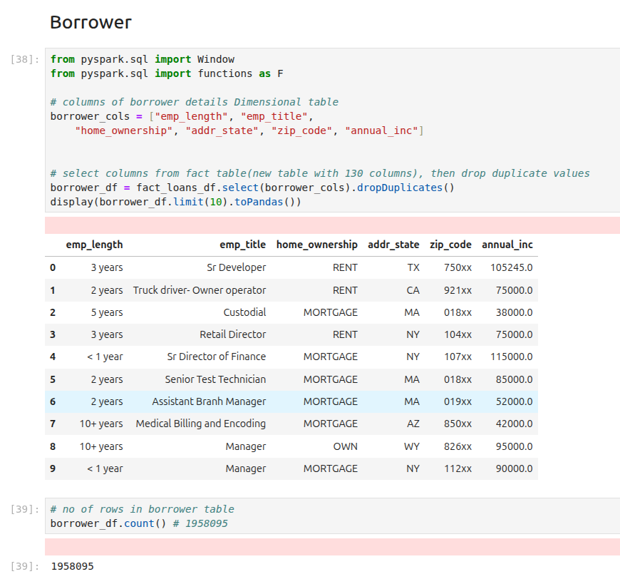
BORROW TABLE

Slide 17
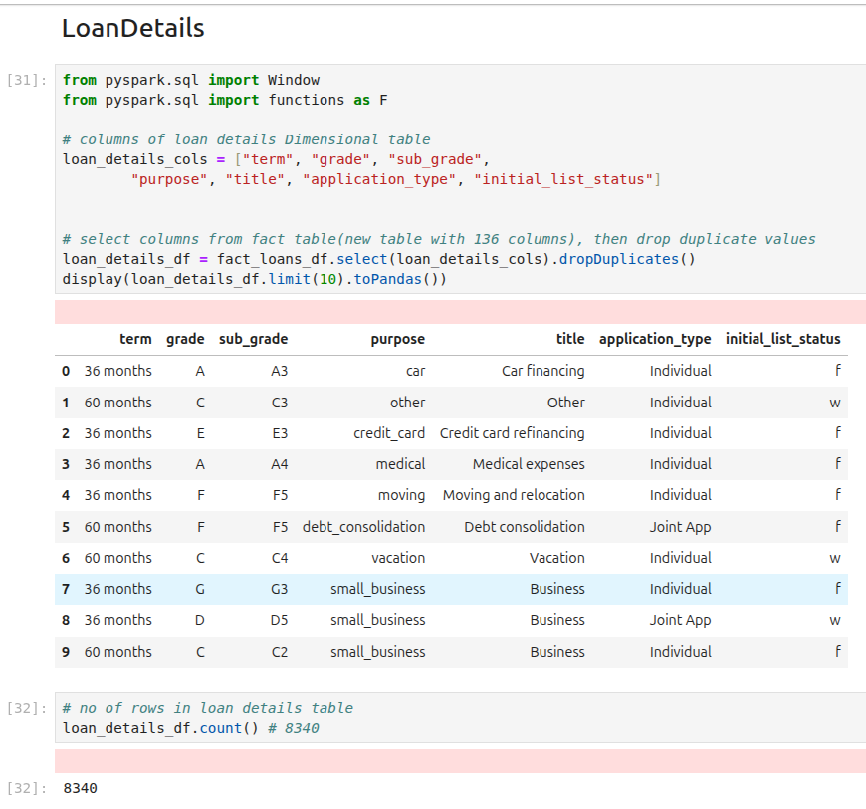
LOAN-DETAILS TABLE

Slide 18
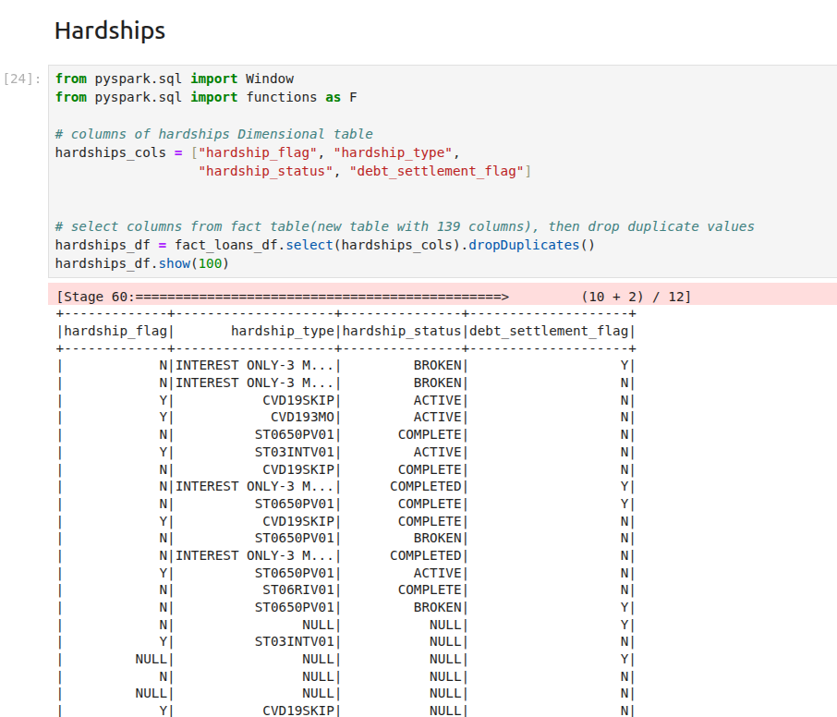
HARDSHIPS TABLE

Slide 19
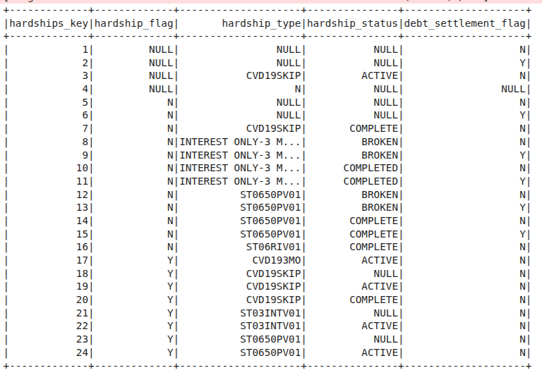
HARDSHIPS TABLE

Slide 20
BATCH
PIPELINE

Slide 21
BATCH PIPELINE OVERVIEW
Impact on Businesses
Batching collects data over time and processes it in bulk, making operations more efficient and cost-effective. It improves data quality through validation and cleaning, and provides consistent insights for decision-making. Businesses benefit by reducing overhead, ensuring reliability, and focusing resources on strategic initiatives..
Key Benefits
Batching makes data processing faster and cheaper, reduces system load, handles large datasets easily, and improves data quality through cleaning and validation before use.

Slide 22
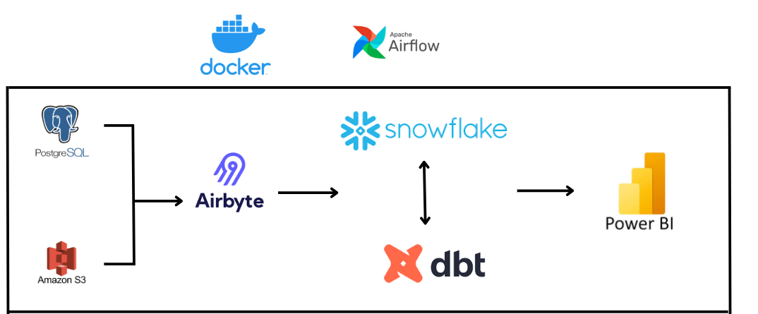
BATCH PIPELINE

Slide 23








bATCH PIPELINE
Data Sources
S3 , Postgresql
Visualization
PowerBI
Transformation and Loading
Extraction
Airbyte
dbt , Snowflake

Slide 24
SOURCES

Slide 25
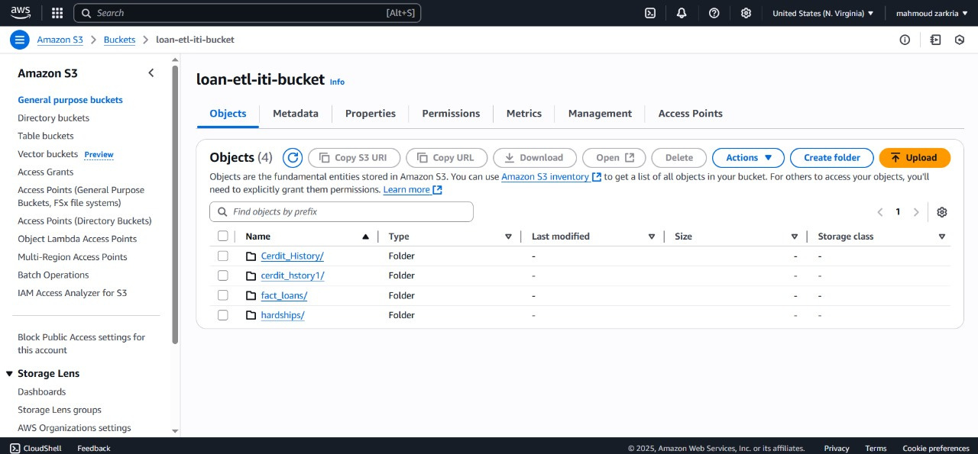
AWS S3

Slide 26
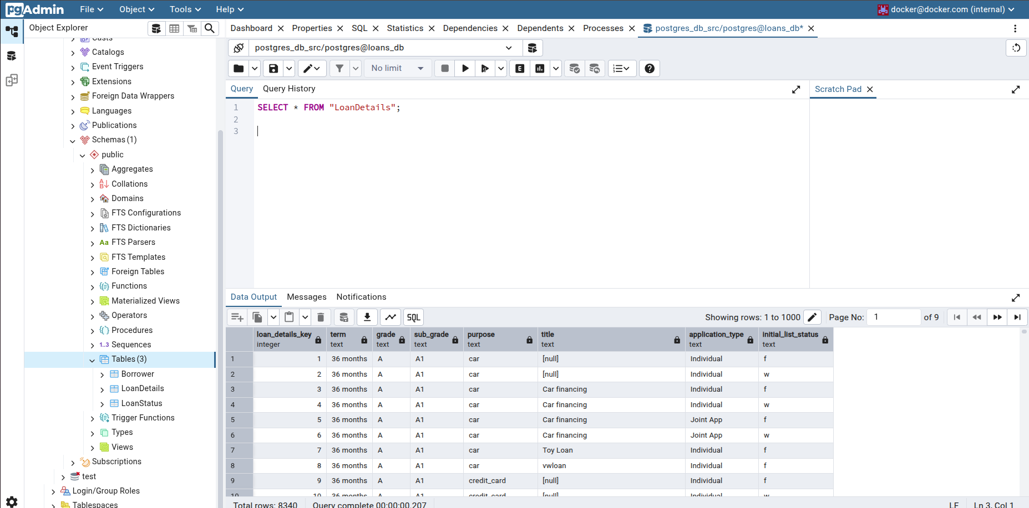
POSTGRES

Slide 27
EXTRACTION

Slide 28

bATCH PIPELINE
Data Sources
S3 , Postgresql
Visualization
PowerBI
Transformation and Loading
Extraction
Airbyte
dbt , Snowflake

Slide 29
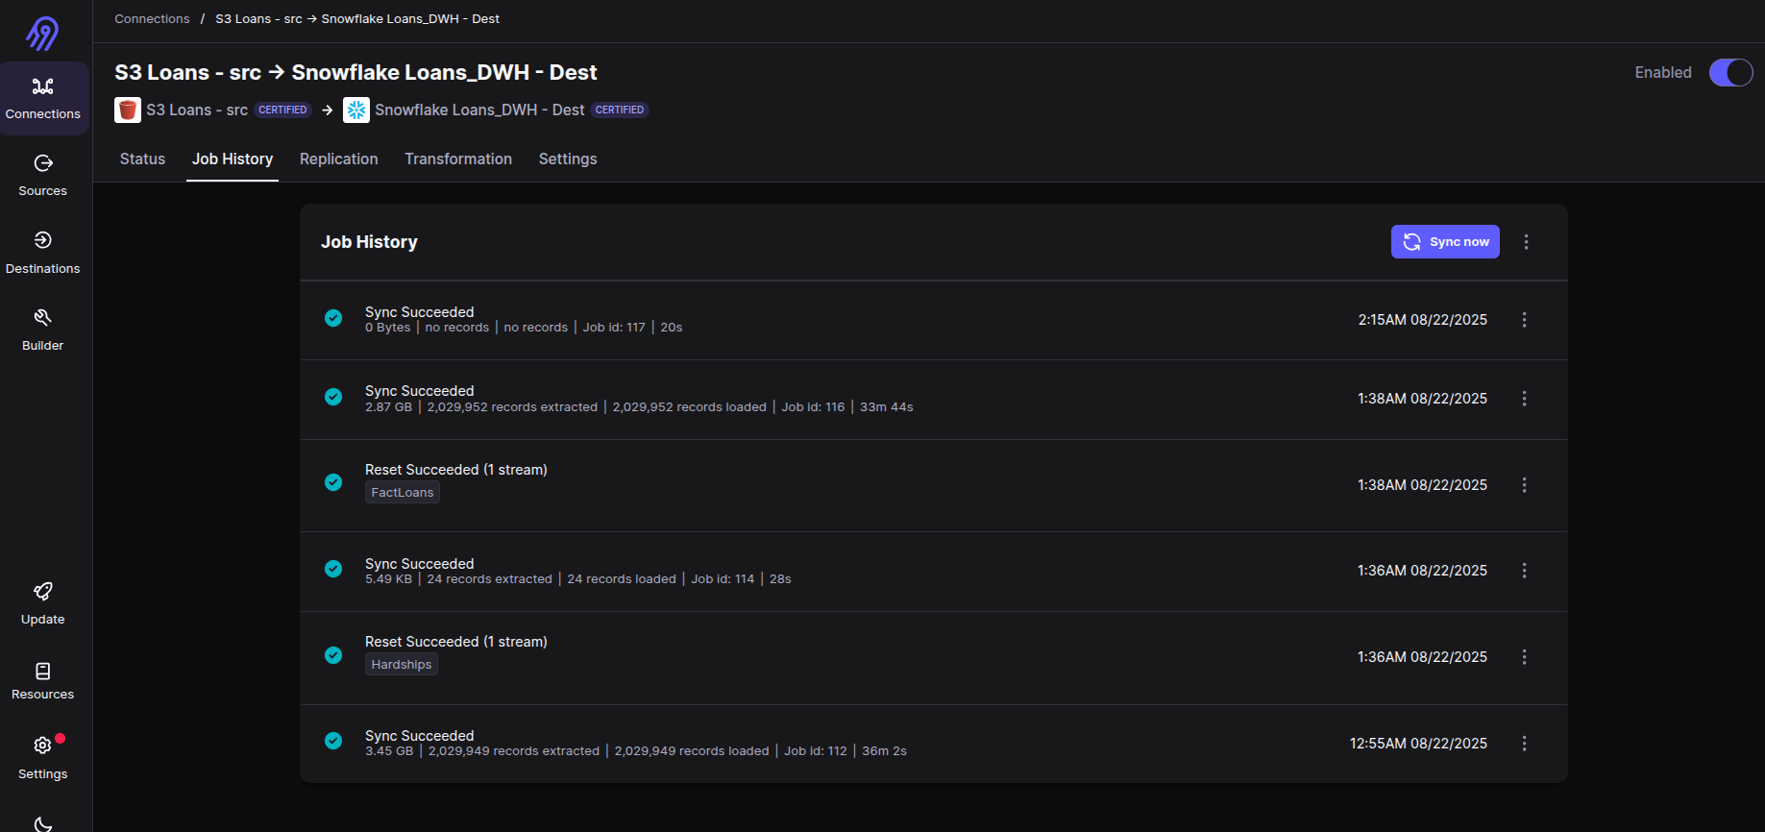
AIRBYTE FULL LOAD (MANUAL)

Slide 30
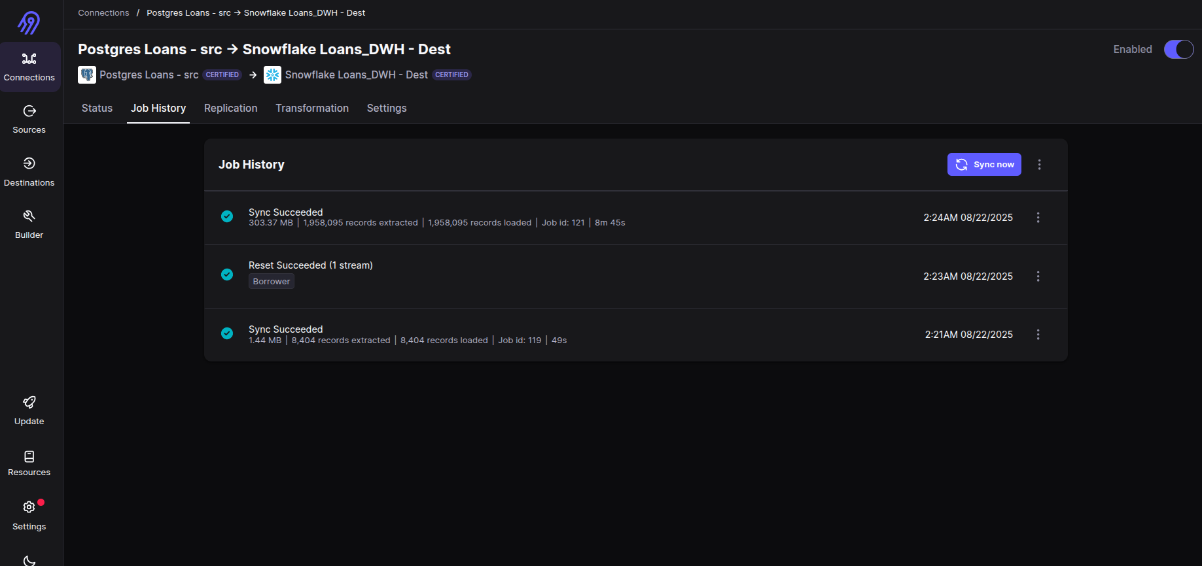
AIRBYTE FULL LOAD (MANUAL)

Slide 31
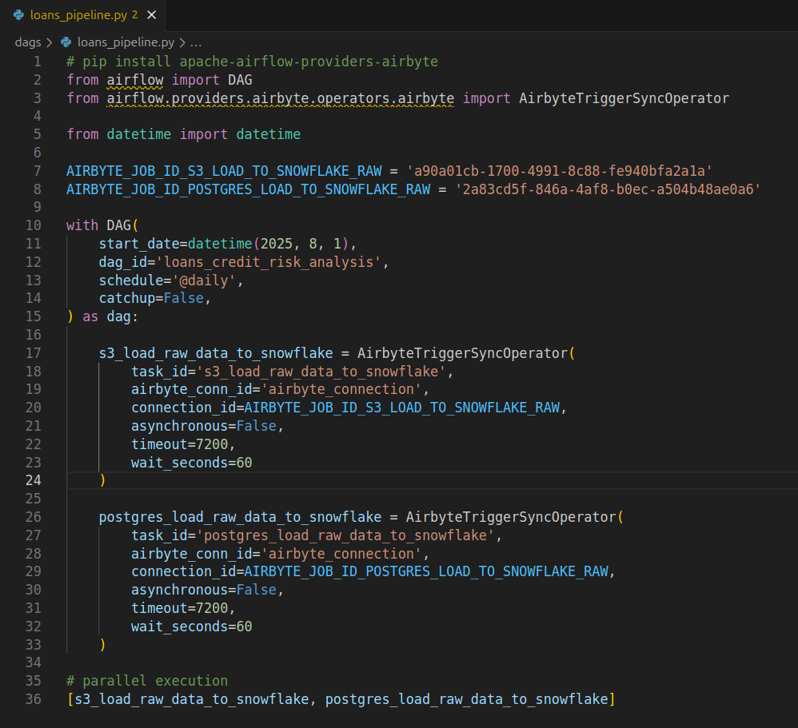
AIRFLOW DAG

Slide 32
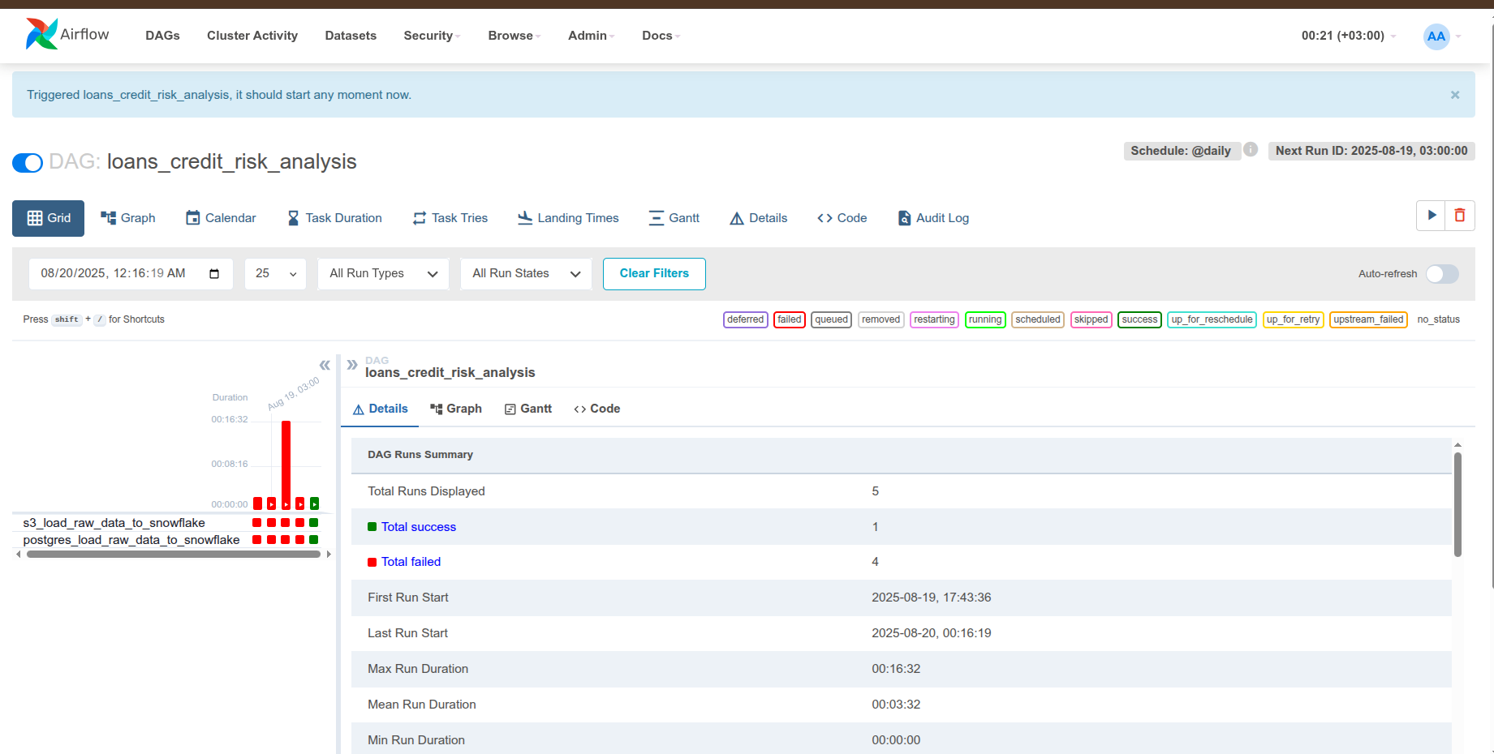
AIRFLOW DAG

Slide 33
bATCH PIPELINE
Data Sources
S3 , Postgresql
Visualization
PowerBI
Transformation and Loading
Extraction
Airbyte
dbt , Snowflake

Slide 34
TRANSFORMATION AND LOADING

Slide 35
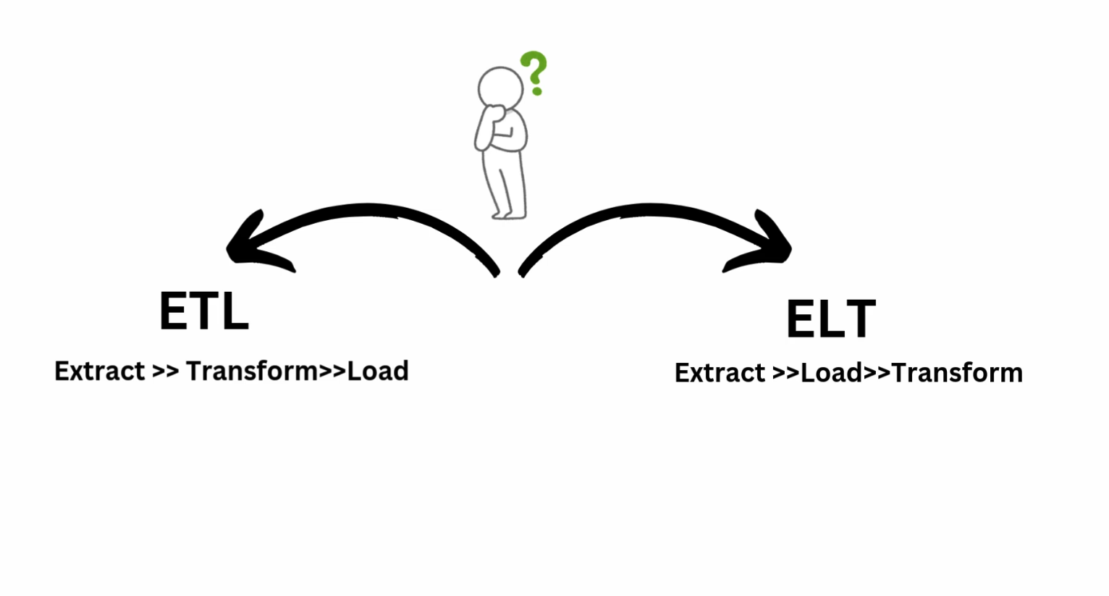
TRANSFORMATION

Slide 36

TRANSFORMATION
What is dbt and Why ?

Slide 37
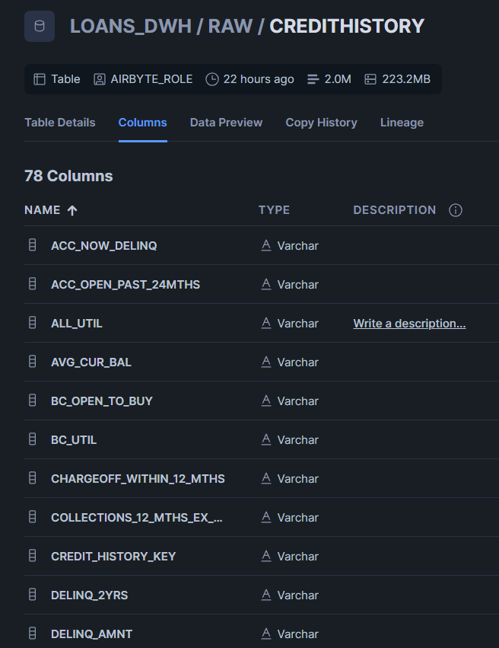
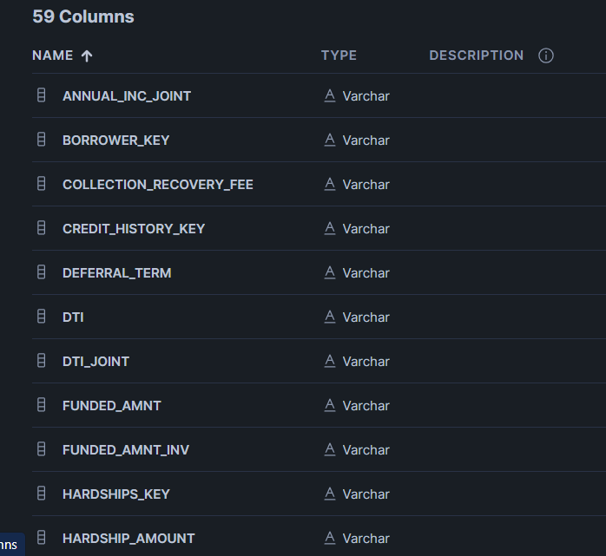
TRANSFORMATION
Data Problems:
Data type

Slide 38
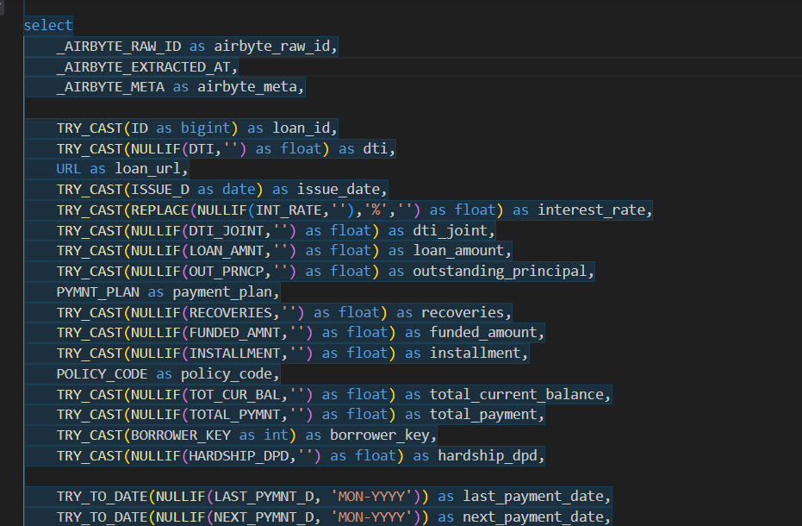
TRANSFORMATION
Solve

Slide 39
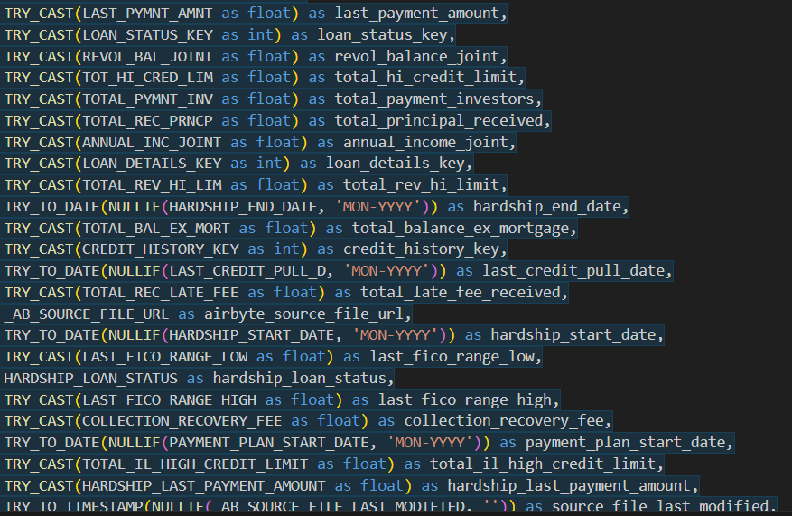
TRANSFORMATION
Solve

Slide 40
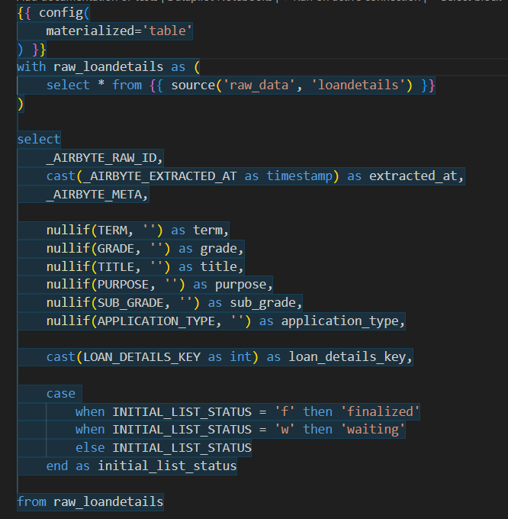
TRANSFORMATION
Solve

Slide 41
TRANSFORMATION
Data Problems:
column name

Slide 42
TRANSFORMATION
Data Problems:
column name

Slide 43
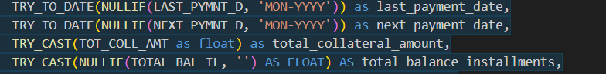
TRANSFORMATION
Data Problems:
column name

Slide 44
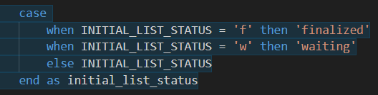
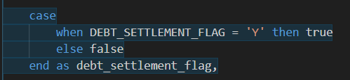
TRANSFORMATION
Data Problems:
Non-standardized

Slide 45
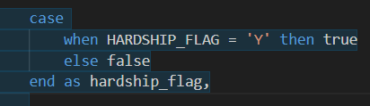
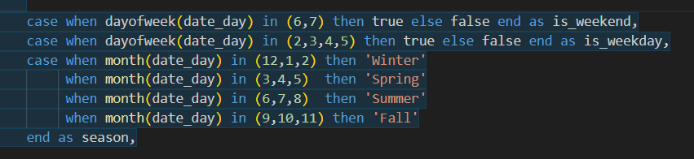
TRANSFORMATION
Data Problems:
Non-standardized

Slide 46
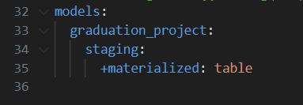
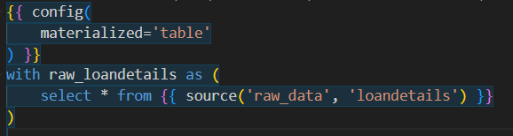
TRANSFORMATION
How are models stored and managed in Snowflake?
Materialization :
view
table
incremntal
ephemeral

Slide 47
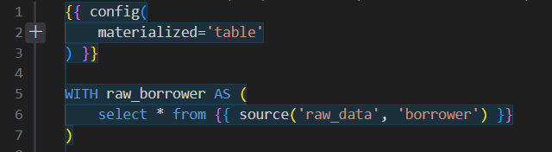
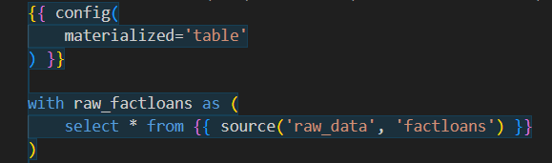
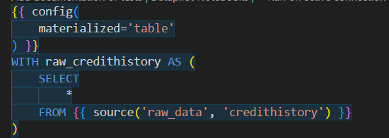
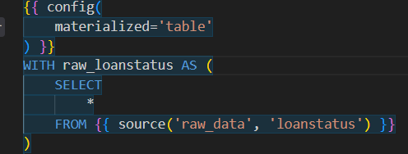
TRANSFORMATION

Slide 48
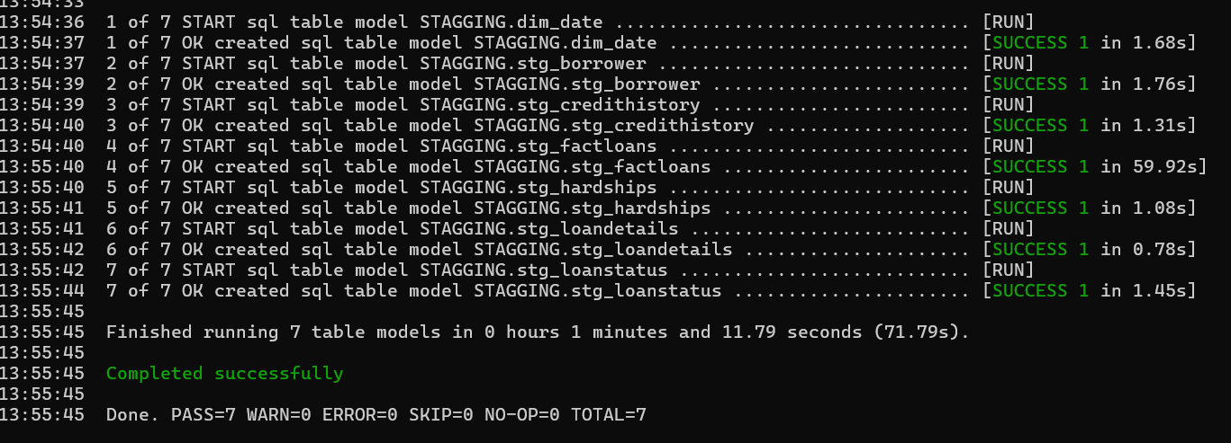
TRANSFORMATION

Slide 49
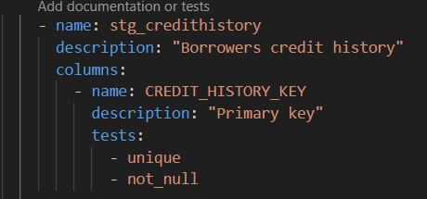
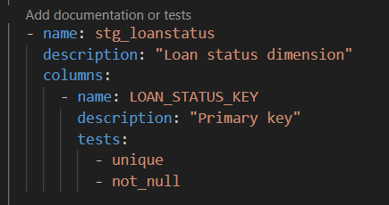
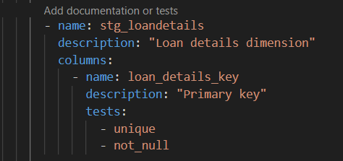
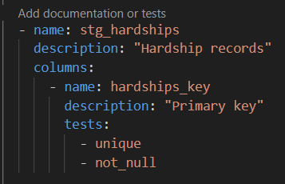
TRANSFORMATION
Data Quality Tests
Unique
Not Null

Slide 50
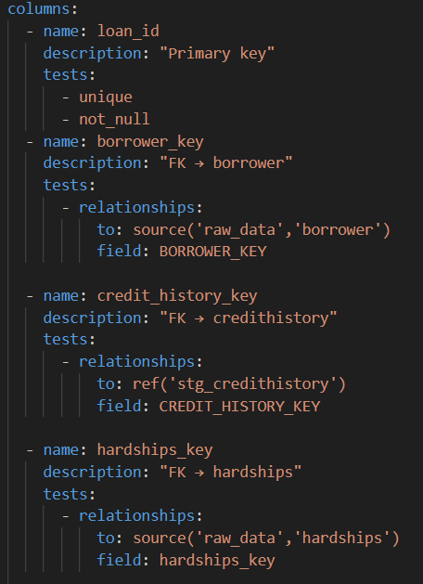
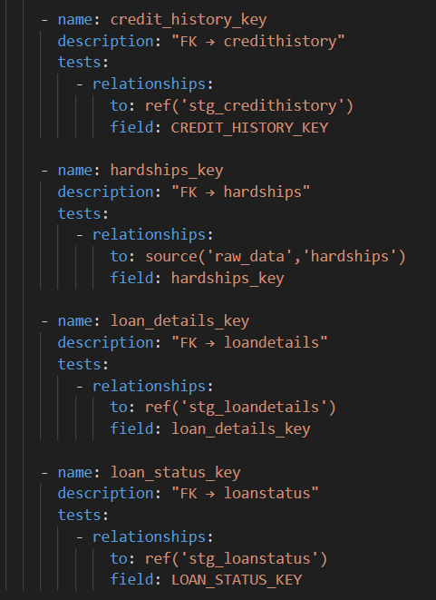
TRANSFORMATION
Referential Integrity

Slide 51
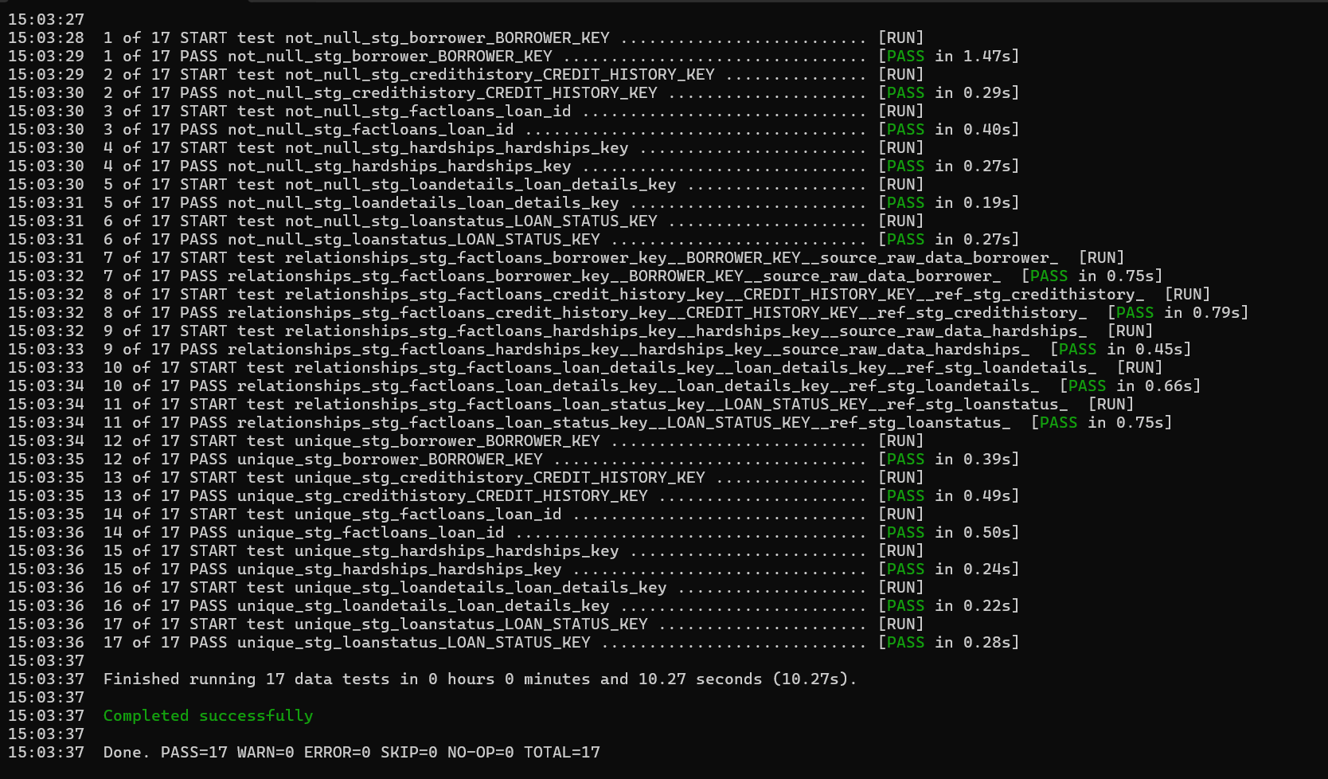
TRANSFORMATION

Slide 52
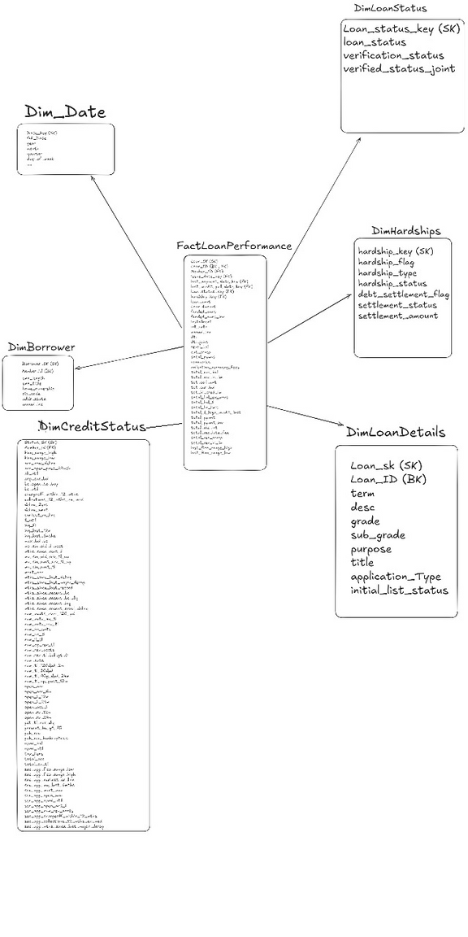
TRANSFORMATION

Slide 53
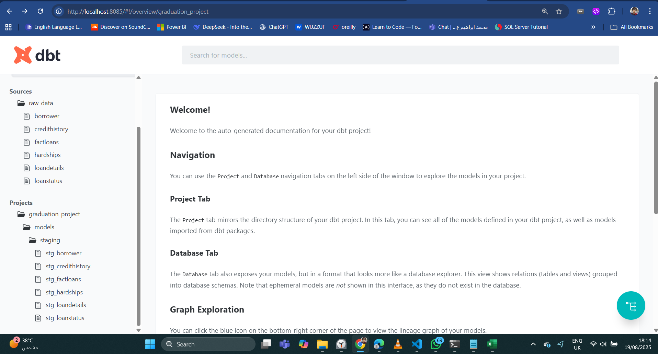
TRANSFORMATION
dbt Documentation

Slide 54
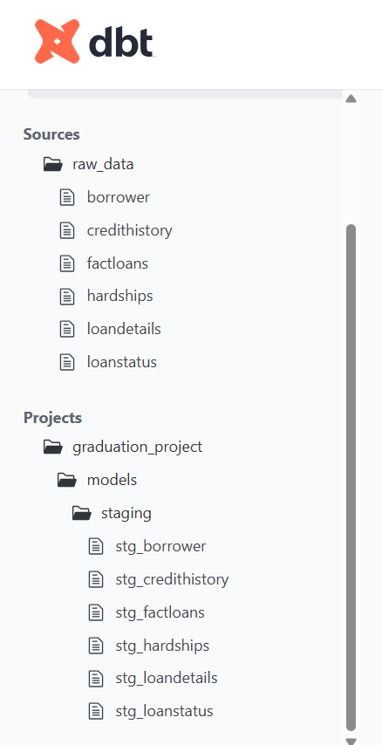
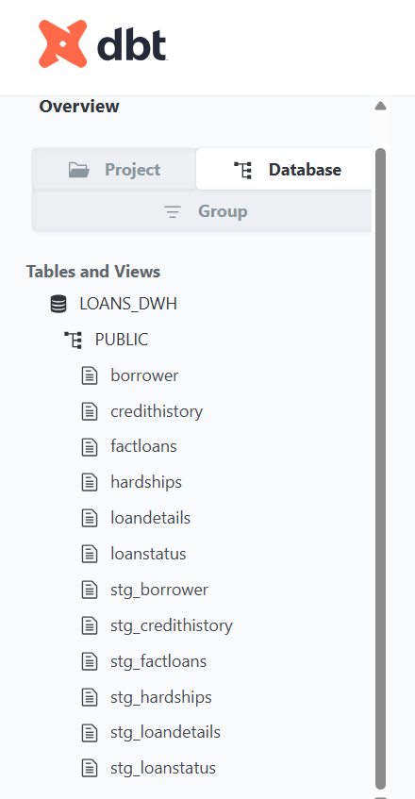
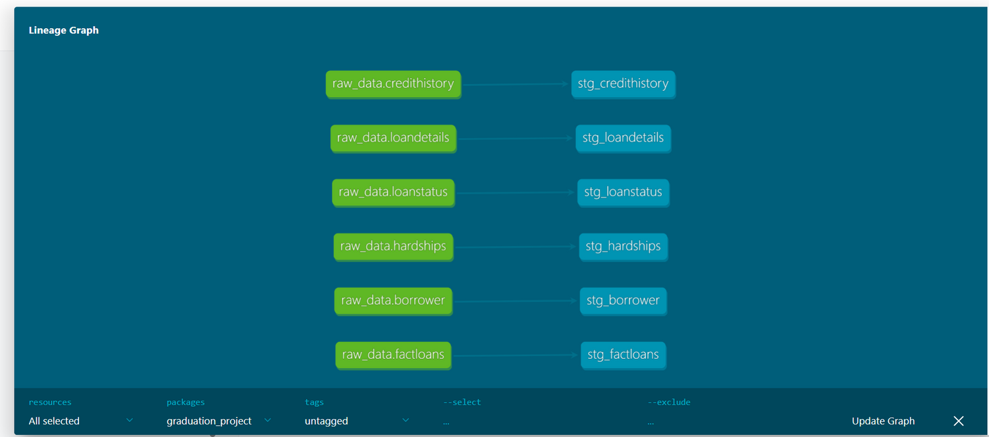
TRANSFORMATION

Slide 55
SCHEDULING

Slide 56

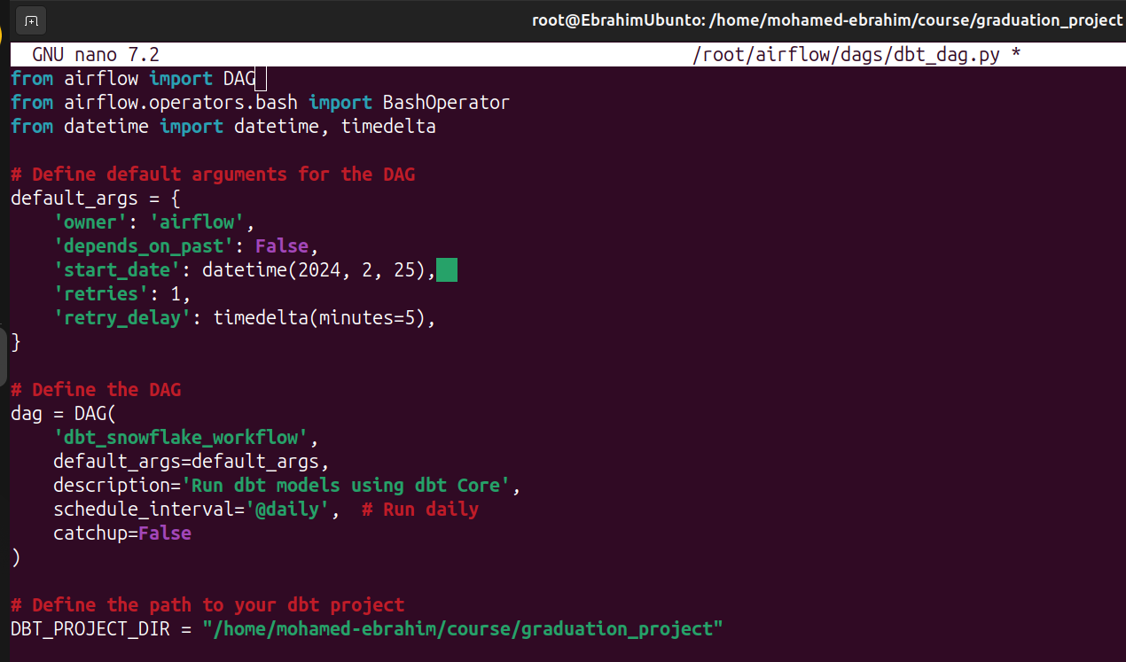
SCHEDULING
Airflow with dbt

Slide 57
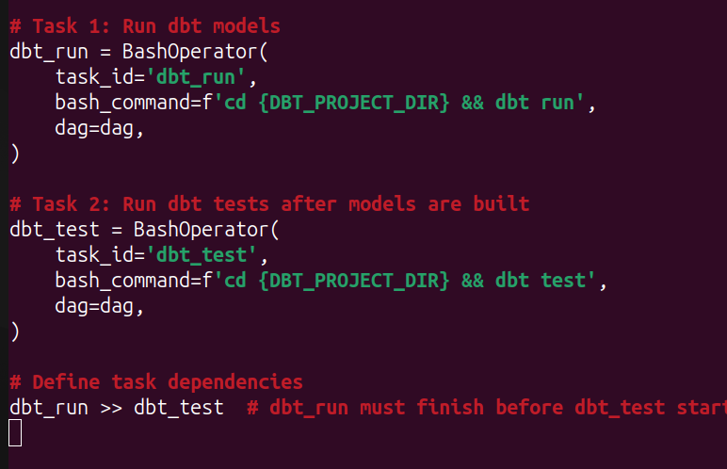
SCHEDULING

Slide 58
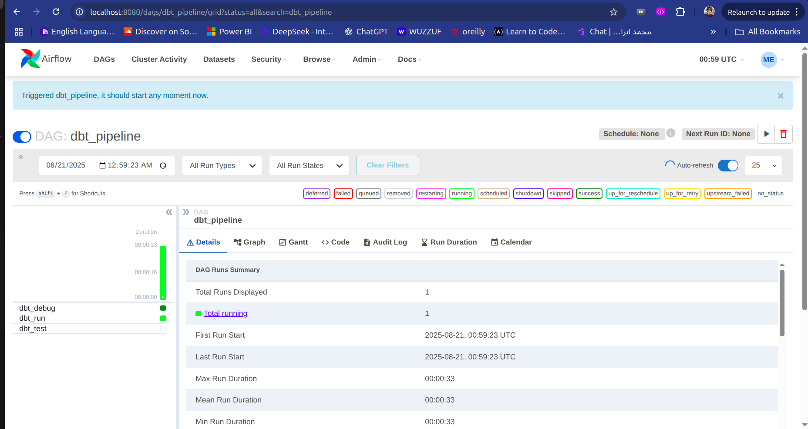
SCHEDULING

Slide 59

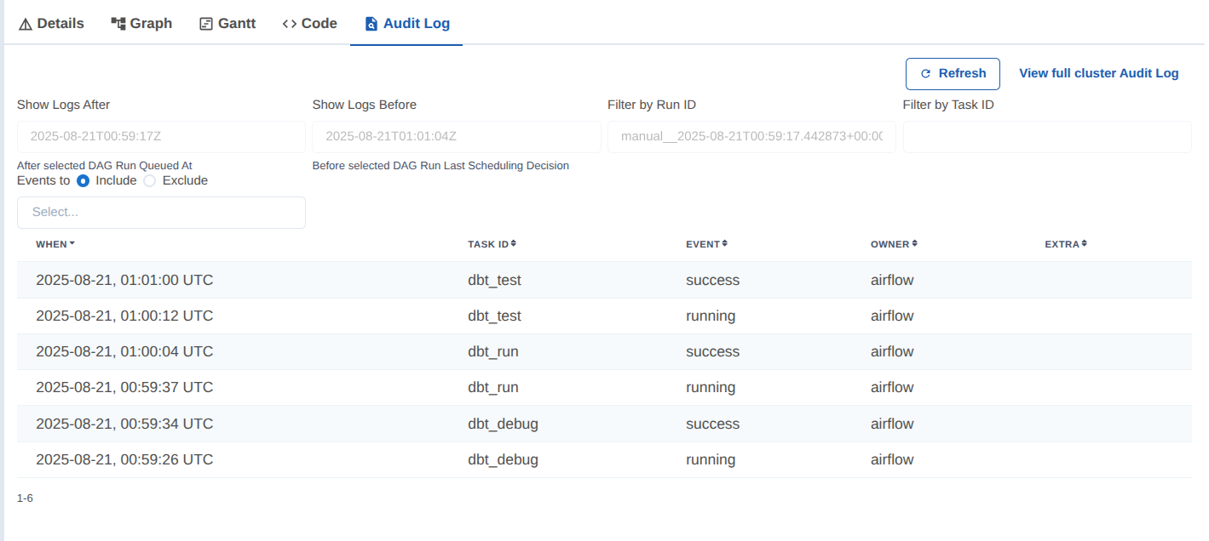
SCHEDULING

Slide 60
bATCH PIPELINE
Data Sources
S3 , Postgresql
Visualization
PowerBI
Transformation and Loading
Extraction
Airbyte
dbt , Snowflake

Slide 61
DATA MODEL

Slide 62
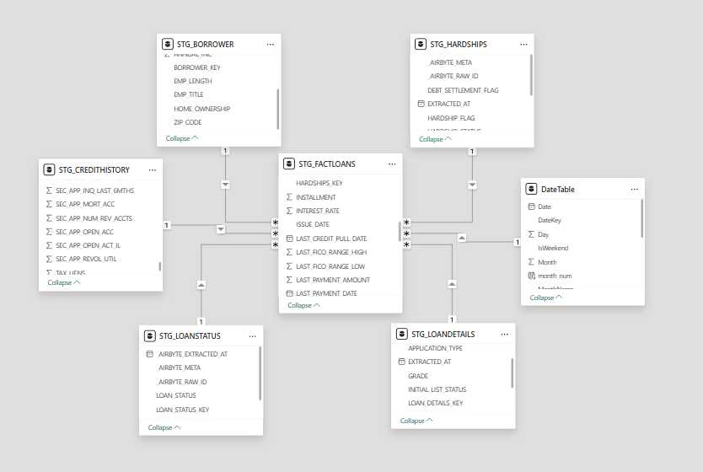
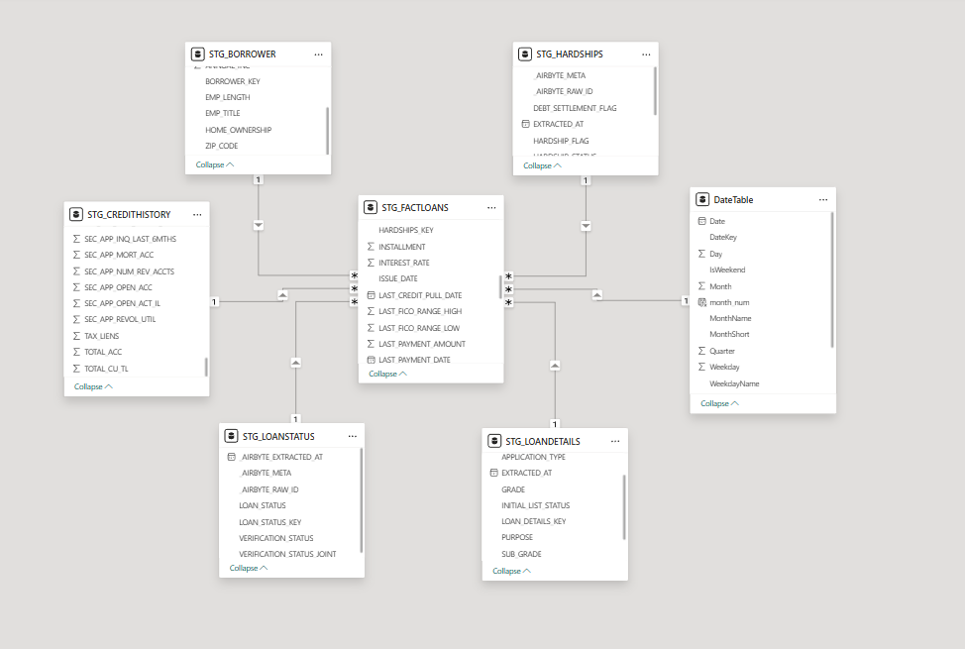

Slide 63
DASHBOARD

Slide 64
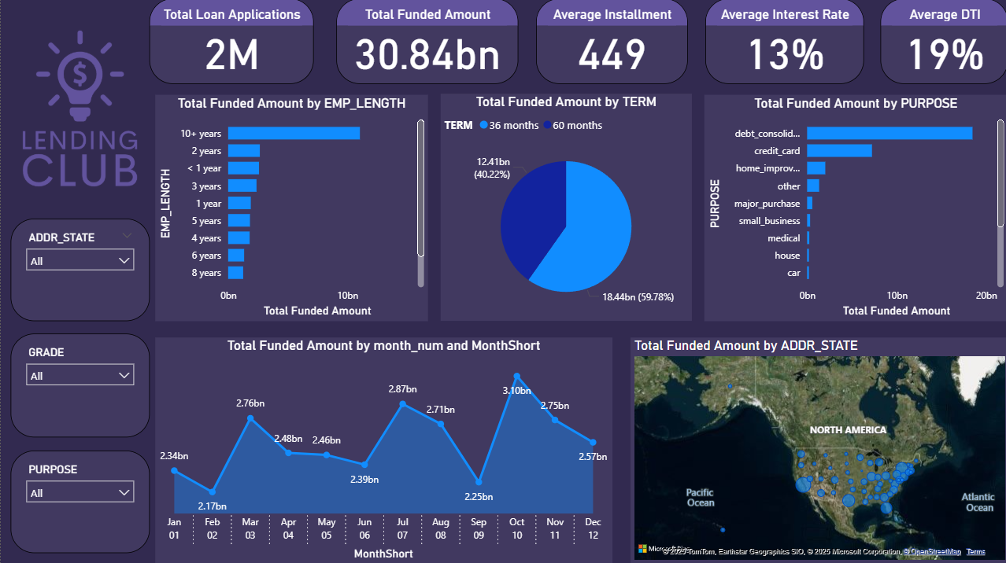

Slide 65
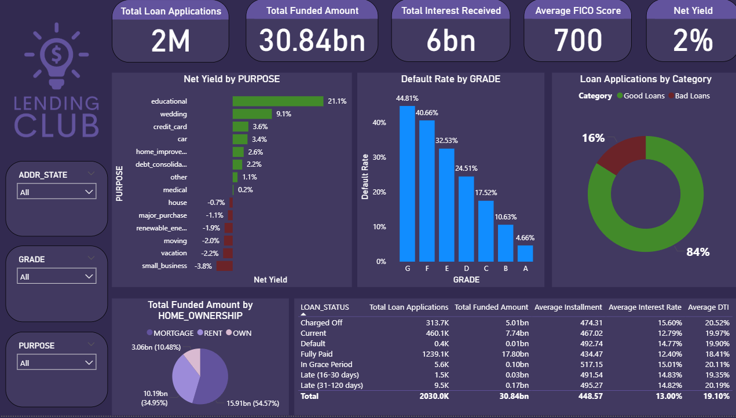

Slide 66
STREAMING
PIPELINE

Slide 67
STREAMING PIPELINE OVERVIEW
Impact on Businesses
Real-time monitoring of the number of charged-off loans.
Portfolio management and monitoring
Interest and principal received monitoring in a real time
Total Delinquent Amount Monitoring
Key Benefits
Better management and monitoring of loans, higher detection, and thus a higher response rate to defaults and charged-off loans.

Slide 68


STREAMING PIPELINE ARCHITECTURE

Slide 69








STREAMING DATA PIPELINE
Snowflake
Kafka
Grafana
Storing Raw data , Processing ,
Storing Processed Data
Simulating real-time API
Producer , Broker , Consumer
Near Real-Time Dashboard
EC2 , S3 , Python

Slide 70


SIMULATING WEB API

Slide 71


SIMULATING WEB API
http:44.201.87.53:5000/stream

Slide 72
STREAMING DATA PIPELINE
Snowflake
Kafka
Grafana
Storing Raw data , Processing ,
Storing Processed Data
Simulating real-time API
Producer , Broker , Consumer
Near Real-Time Dashboard
EC2 , S3 , Python

Slide 73

KAFKA PRODUCER

Slide 74

CHANGE HANDLER

Slide 75

KAFKA CONSUMER

Slide 76
STREAMING DATA PIPELINE
Snowflake
Kafka
Grafana
Storing Raw data , Processing ,
Storing Processed Data
Simulating real-time API
Producer , Broker , Consumer
Near Real-Time Dashboard
EC2 , S3 , Python

Slide 77

PROCESSED TABLE CREATION

Slide 78

STREAM CREATION

Slide 79

PROCESSING TASK CREATIONS

Slide 80

CREDIT SCORE TASK

Slide 81

PROCESS LOAN TASK

Slide 82

PAYMENT RECEIVED TASK

Slide 83
STREAMING DATA PIPELINE
Snowflake
Kafka
Grafana
Storing Raw data , Processing ,
Storing Processed Data
Simulating real-time API
Producer , Broker , Consumer
Near Real-Time Dashboard
EC2 , S3 , Python

Slide 84

STREAMING DASHBOARD

Slide 85
THANK
YOU

Slide 86







OUR TEAM LINKEDIN
Khaled Salah
01021215148
Ahmed El-Sayed
01128057385
Abdelrahman Tarek
01006066722
Mohamed Ibrahim
01090256929
Mohamed Badr
01116403903
Mahmoud Khalid
01000188197

